Slide 1
Information System.

Slide 2
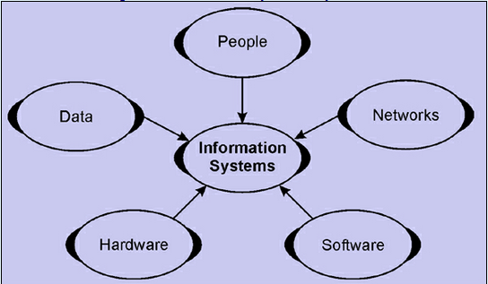
What is Information System?
Computer Based Information System is a combination of people, hardware, Software, Communications device, networks and data resources that processes data and information for a specific purpose.
There are different types of information system
Manual Information System(paper and pencil)
Formal Information System (Word to Mouth)
Informal Information System (Written Procedures)
Computer based Information System

Slide 3
Computer Based Information System
A Computer based Information system is a combination of People, IT and business Processes that helps management in taking important decision to carry out the business successfully.
Components of CBIS:
Hardware
Software
Databases
Telecommunications
People
Procedures
And together they are configured to collect , manipulate, store and Process data into information.

Slide 4
Purpose of Information System
The purpose of an information system is to turn raw data into useful information that can be used for decision making in an organization.
Information systems are designed to support a particular process within an organization or to carry out very specific analysis.
Businesses use Information Systems
To solve Problems.
To make sound decisions.
To achieving the specific goals.

Slide 5
Types of Computer Based Information System
Office Automation System
Transaction Processing System
Management Information System
Decision Support System
Expert System

Slide 6
Office Automation System
Office automation system is an information system which is computer based that collects , processes, stores and transmits electronic messages.
Office automation refers to the various computer machinery and software used to digitally create , collect , store and manipulate and relay office information needed for accomplishing basic tasks.
Functions of OAS
Electronic Publishing
Electronic Communication
Electronic Collaboration
Image Processing
Office Management

Slide 7
Components of OAS
There are basic three components of OAS
Data Storage and Manipulation. This component is responsible of capturing and editing of data-data may be in any form like text, image , audio, video etc.
Data Exchange. The stored data can be exchanged and can be sent to multiple user at one time. Electronic mail and voice mail can be used to transfer information.
Data Management. Data management is the last component of OAS. Task Management, scheduling system and reminder Programs etc. used for controlling and monitoring the OAS.

Slide 8
Management Information System
MIS is a computer based system that Provides flexible and speedy access to accurate.
Organized collection of people, procedures, software, databases, and devices that provides routine information to managers and decision makers.
MIS facilitates the decision making process and enable the organizational planning, control and operational functions to be carried out effectively.
MIS is an organized approach for obtaining relevant and timely information on which managerial decisions are based.
MIS
Computer Science
Business

Slide 9
Role of MIS
Understand the Business.
Quality, Risk, Inventory , Market analysis
Stake holders, customer behavior analysis
Satisfies the needs through query systems, analysis systems, and modeling systems.
Helps in strategic planning, Management Control, Operational control and Transaction Processing.
Hence MIS plays a vital role in management, administration and operations of an organization.

Slide 10
Transaction Processing System.
A Transaction Processing system (TPS) is a type of information system that collects, stores, modifies, and retrieves the data transaction of an enterprise.
A TPS is an information system that records and processes and organization routine business activities.
Types of Transaction Processing System
Batch Processing System
Real time System
Batch processing refers to running batch jobs on a computer system. Examples include billing, report generation, data format conversion, and image processing. These tasks are called batch jobs.
Real-time data processing is the execution of data in a short time period, providing near-instantaneous output. Examples Online shopping, Pay Pal, ATM etc.

Slide 11
Decision Support System
A DSS is computer based information system that supports business and organizational decision- making activities.
A Properly designed DSS is an interactive software based system intended to help decision makers compile useful information from raw data, documents, personal knowledge and/or business models to identify and solve problems and make decisions.
Components of DSS
Data Base Management System (DBMS)
Model Based Management System (MBMS)
Dialog Generation and Management System (DGMS)

Slide 12
The Architecture of DSS
MBMS
DBMS
Model Base
Data Base
DGMS
DSS User

Slide 13
Components of DSS
The User
Data Base
Planning Languages
Model Base
The User:-
The user of DSS is usually a manager with an unstructured or semi- structured problem to solve. Manager and Staff Specialist are users who are willing to use complex system in their day-to-day work.
Data Base:-
The DSS includes one or more databases that contain both routine and non- routine data from both internal and external sources. Data bases has three levels
Physical , Logical, and External level.

Slide 14
Components of DSS
Planning Languages:-
There are two types of language General Purpose and Special Purpose languages. Spread Sheet are good examples of general purpose planning language. SAS and SPSS are examples of Special Purpose Language.
Model Base:-
The Planning language in a DSS allows the users to maintain a dialogue with the model base which is the brain of DSS because it performs data manipulations and computations with the data provided to it by the user and the database.

Slide 15
Expert System
An Expert system is a highly developed DSS that utilize knowledge generally possessed by an expert to share a problem.
A characteristics of expert systems is the ability to declare or explain the reasoning process that was used to take decision.
Some of the business applications of Expert Systems are
Accounting and Finance
Manufacturing
General Business
Marketing
Personnel (HRM)

Slide 16
Expert System

Slide 17
Properties of Expert System
Availability
One or more experts are capable of communicating how they go about the solving problems to which the expert system will be applied.
Complexity
Solution of the problems for which the expert systems will be used is a complex task.
Domain
The domain , or subject area of the problem is relatively small and limited to a relatively well- defined problem area.
Expertise
Solutions to the Problem require the effort of experts.
Structure
The Solution Process must be able to cope with ill- structured, uncertain, missing and conflicting data and a dynamic problem solving situation.

